Slide 1

Operators in Java
Shubham Rawat

Slide 2
Session Objective
01 | Understand different types of Java operators
02 | Apply operators in expressions and logic
03 | Understand operator precedence
04 | Differentiate between ++i and i++
05 | Build logical and arithmetic programs

Slide 3
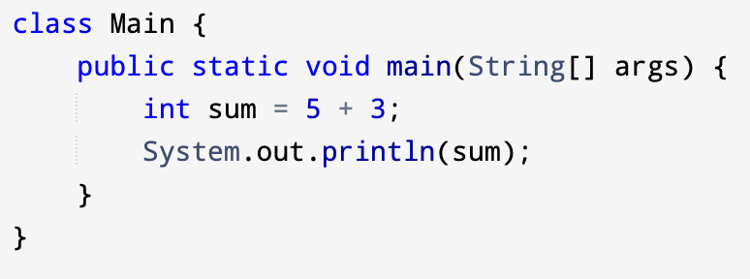
What is an Operator?
An operator performs an operation on variables or values
Used to form expressions
Produces a result

Slide 4

Types of Operators in Java
Arithmetic Operators
Relational Operators
Logical Operators
Bitwise Operators
Unary Operators
Ternary Operator

Slide 5

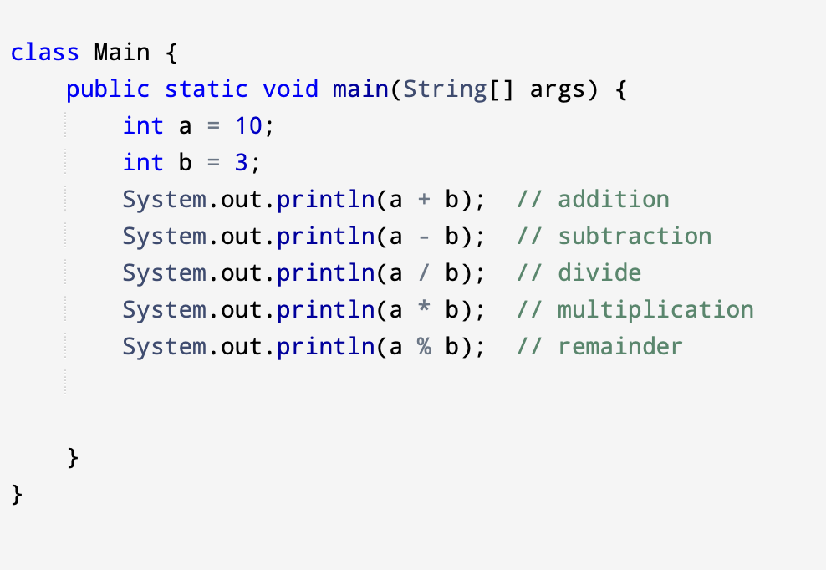
Arithmetic Operators
Used for mathematical calculations.

Slide 6
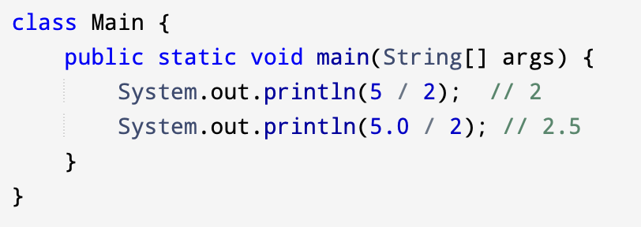
Division Important Note
Integer division removes decimal part
Division by zero causes error

Slide 7
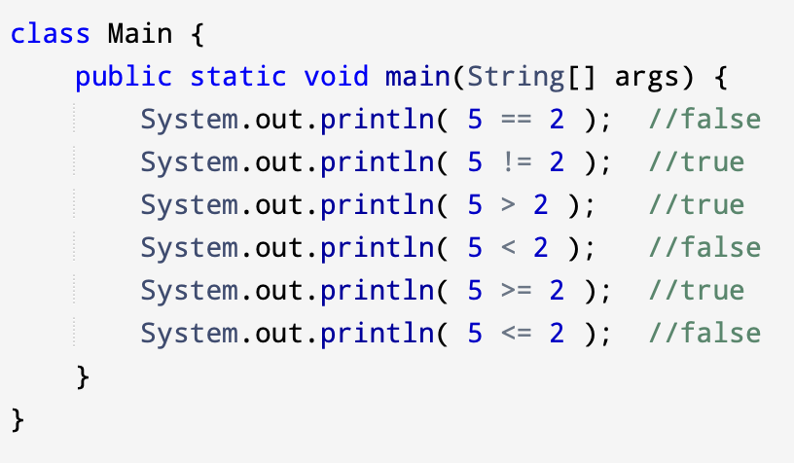
Relational Operators
Used to compare values.
Result is always boolean (true/false).
Operator | Meaning
== | Equal to
!= | Not equal
> | Greater than
< | Less than
>= | Greater or equal
<= | Less or equal

Slide 8
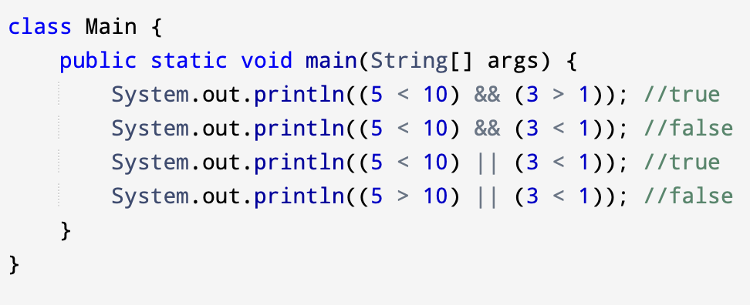
Logical Operators
Operator | Meaning
&& | AND
! | NOT
Used to combine conditions.

Slide 9
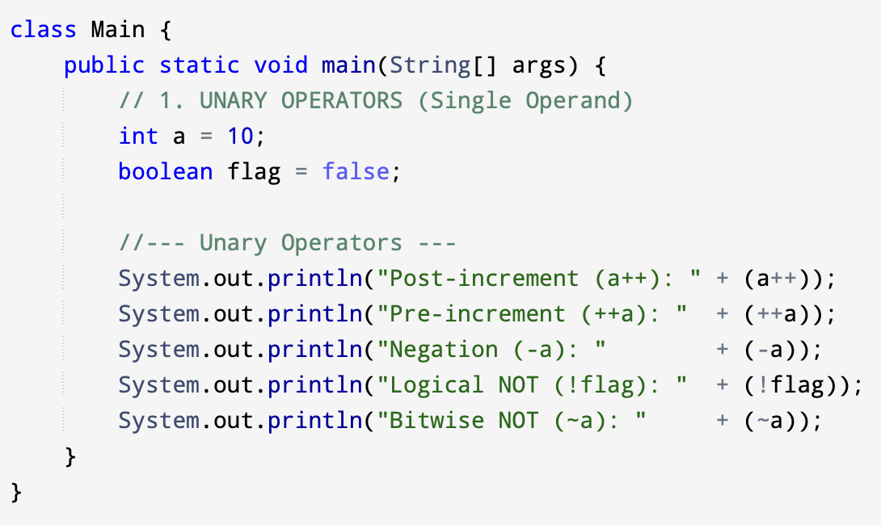
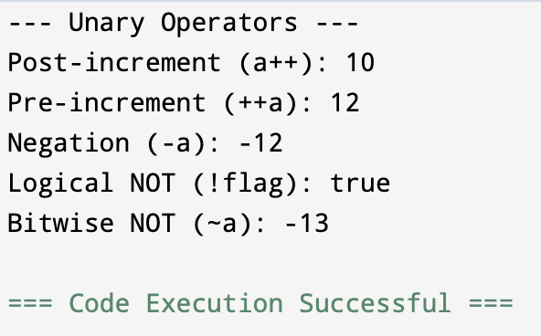
Unary Operators
Operate on single variable.
Operator | Meaning
+ | Positive
- | Negative
++ | Increment
-- | Decrement
! | Logical NOT

Slide 10
++i vs i++
Pre-Increment (++i)
Increment first, then use value
Post-Increment (i++)
Use value first, then increment
int x = 5;
System.out.println(++x); // 6
System.out.println(x++); // 6
System.out.println(x); // 7

Slide 11
Bitwise Operators
Work at binary level.
Operator | Meaning
& | AND | 1 if both bits are 1
^ | XOR | 1 if bits are different
~ | NOT | Inverts every bit (0 to 1, 1 to 0)
<< | Left shift | Shifts bits left; multiplies by powers of 2
>> | Right shift | Shifts bits right; preserves sign bit
>>> | Unsigned Right Shift | Shifts bits right; always fills with 0
| | Bitwise OR | 1 if at least one bit is 1

Slide 12
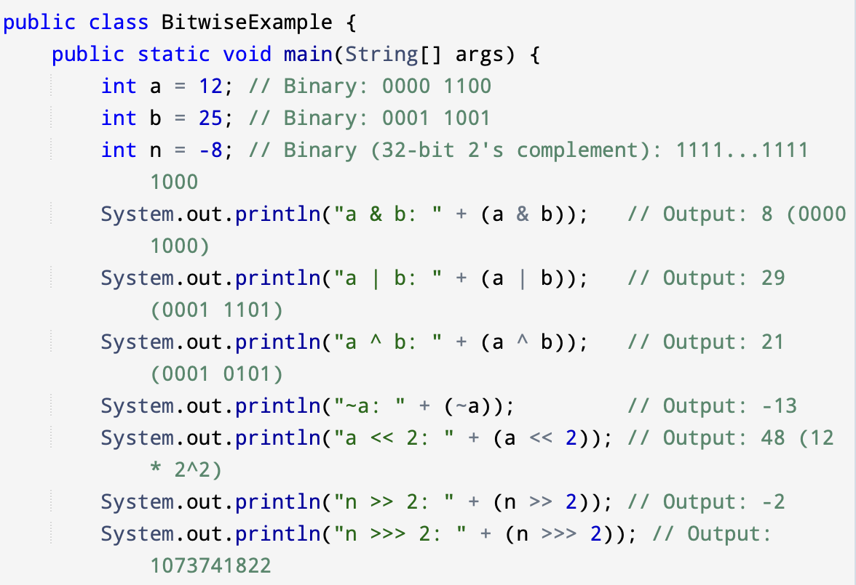
Bitwise Operators
Notes:
Bitwise AND (&): Sets bit to 1 only if both corresponding bits are 1
Bitwise OR (|): Sets bit to 1 if at least one corresponding bit is 1
Bitwise XOR (^): Sets bit to 1 only if corresponding bits are different
Bitwise Complement (~): Inverts all bits (unary operator), Rule: ~N = -(N + 1)
Left Shift (<<): Shifts bits left, fills with 0s on the right, Equivalent to multiplying by 2^positions
Signed Right Shift (>>): Shifts bits right, preserves sign bit, Equivalent to dividing by 2^positions
Unsigned Right Shift (>>>): Shifts bits right, fills with 0s from the left,Converts negative numbers to large positive values

Slide 13
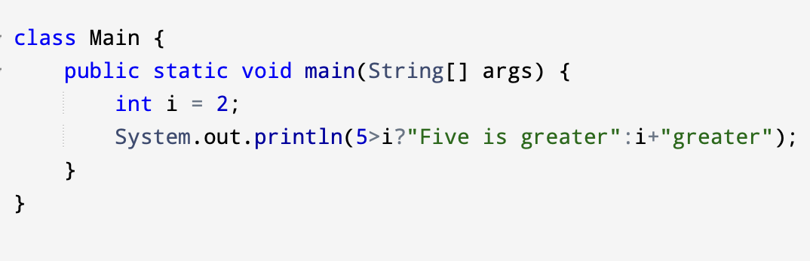
Ternary Operator
Shortcut for if-else.
condition ? value_if_true : value_if_false;
int max = (a > b) ? a : b;

Slide 14
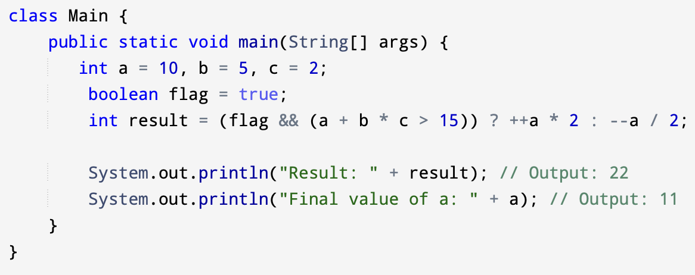
Operator Precedence
Operators are evaluated in a specific order.
High → Low:
Unary (++ , -- , !)
Arithmetic (*, /, %)
Arithmetic (+, -)
Relational (<, >)
Logical (&&, ||)
Ternary
Notes:
Breakdown of Evaluation:
- Parentheses (a + b * c > 15) are evaluated first.
- Inside: b * c (5*2=10) runs first, then a + 10 (10+10=20).
- Then: 20 > 15 is true.
- Logical &&: flag (true) && true results in true.
- Ternary: Since condition is true, it executes the 'true' branch: ++a * 2.
- Pre-increment ++a makes a = 11.
- 11 * 2 = 22.
- Assignment: result = 22.

Slide 15
Practical Task 1
Build a menu-driven arithmetic calculator:
Menu:
Add
Subtract
Multiply
Divide

